Slide 1

Online Ticket Booking System

Slide 2
Introduction to Online Ticketing
Convenience
Efficiency
Transparency
Book tickets from anywhere, anytime. No need to visit physical ticket offices.
Streamlined process, reducing wait times and hassle.
View ticket availability, pricing, and seating options upfront.

Slide 3

Key Features of the System
User Accounts
Event Search
Manage personal information, bookings, and payment details.
Browse events by category, location, or date.
Ticket Inventory
Secure Payment
Real-time display of available tickets and pricing.
Multiple payment options with secure encryption.

Slide 4
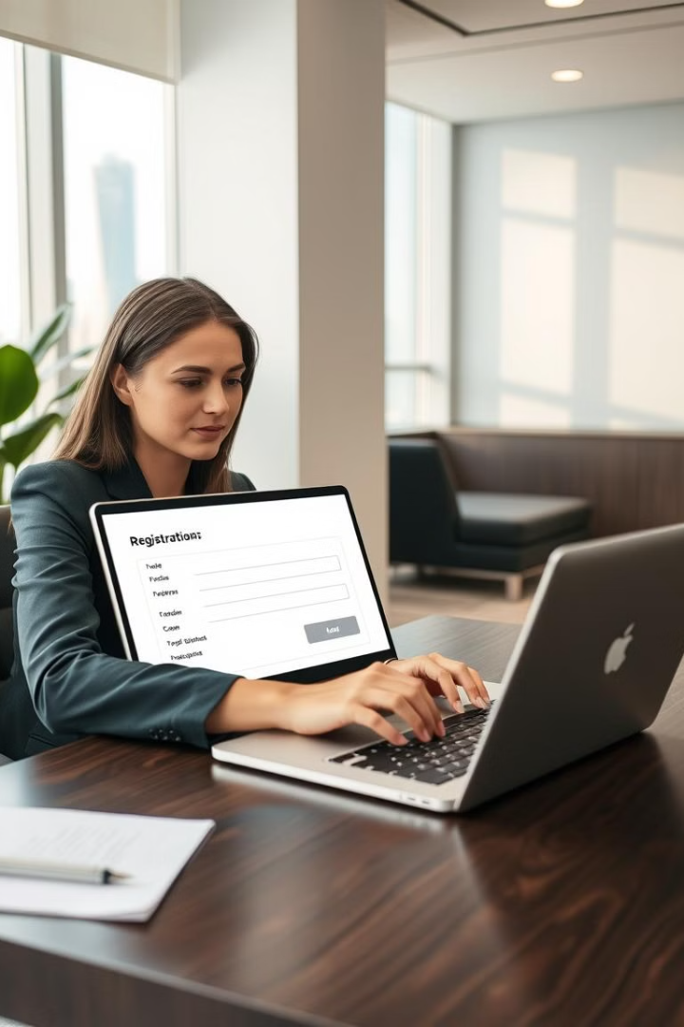



User Registration and Authentication
New Account
Login
Simple registration process with email verification.
Secure login with password protection and two-factor authentication.
Forgot Password
Convenient password recovery options via email or SMS.

Slide 5
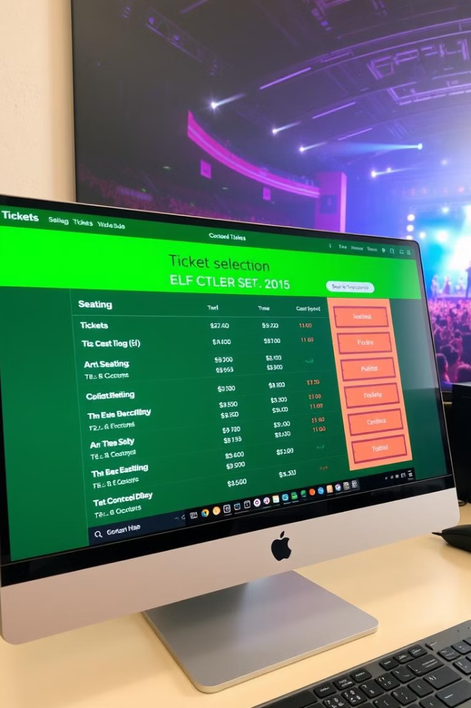




Ticket Selection and Booking
Event Details
Detailed information on event venue, date, and time.
Ticket Options
Browse different ticket types and pricing based on seating.
Quantity Selection
Choose the number of tickets required.
Add to Cart
Securely add tickets to your cart.

Slide 6
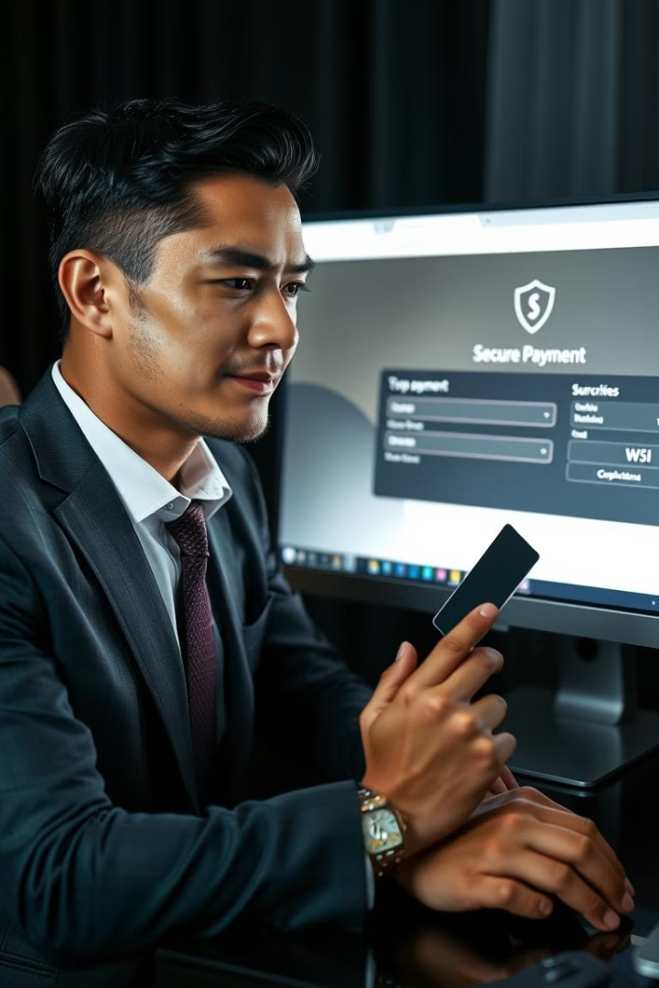
Payment Processing and Checkout
1
Payment Options
Support for major credit cards, debit cards, and digital wallets.
2
Secure Checkout
Encrypted transactions with PCI compliance for secure payment processing.
3
Order Confirmation
Confirmation email with order details and payment receipt.

Slide 7

Seat Selection and Reservation
1
2
Interactive Map
Seat Selection
Clear view of the venue seating layout.
Select desired seats based on availability and pricing.
3
Real-time Updates
Dynamic display of available and reserved seats.

Slide 8
Ticket Confirmation and Delivery
Order Summary
1
Final review of order details and payment confirmation.
Digital Ticket Delivery
2
Email delivery of digital tickets with QR codes.
Physical Ticket Options
3
Optional delivery of printed tickets for events that require them.

Slide 9
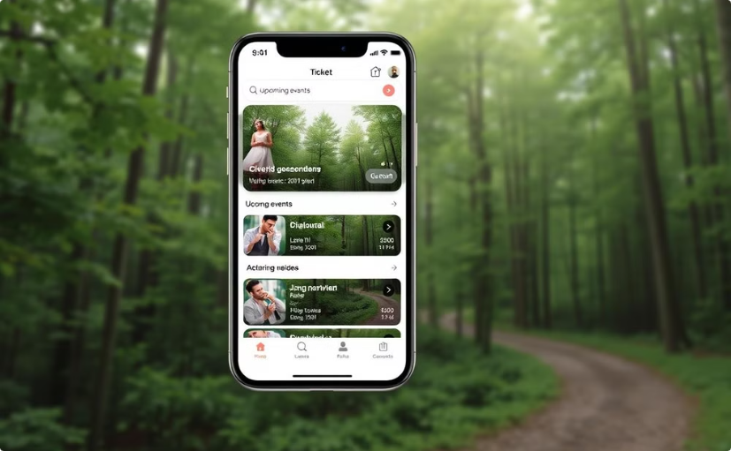
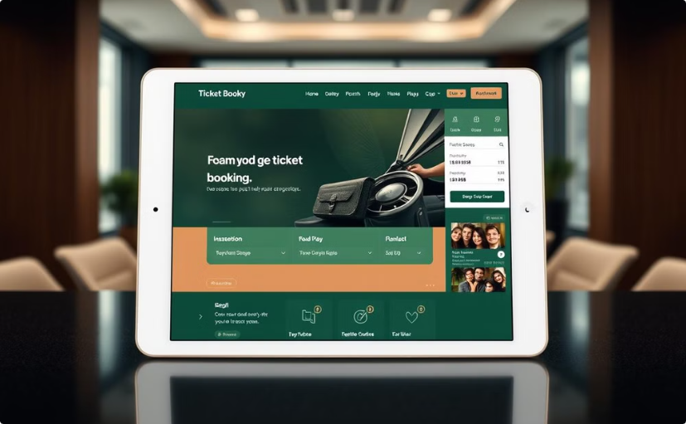
Mobile Optimization and Responsive Design
Mobile App
Responsive Design
Dedicated mobile app for seamless booking experience.
Adaptive layout for optimal viewing on various screen sizes.

Slide 10



Reporting and Analytics
Event Performance
1
Track ticket sales, revenue, and attendance.
User Behavior
2
Analyze user engagement and website traffic.
Marketing Insights
3
Gain insights into marketing campaign effectiveness.

